Slide 1

Health Insurance Data Analysis: Exploring Factors Impacting Health and Wellness Mayur Dusane

Slide 2
Executive Summary
This health insurance data analysis project aimed to explore and analyze a comprehensive dataset containing various health-related factors of individuals.
The analysis focused on understanding the relationships between different variables and their potential impact on health insurance claims and risk assessment.
This data analysis project sheds light on the crucial role of data analytics in the health insurance industry, offering actionable insights for informed decision-making and improved risk assessment practices.

Slide 3

Problem Statement
Health Profile by Age and Gender: Examine the health profiles of individuals by age and gender. Analyze various health parameters such as blood pressure, cholesterol levels, fasting blood sugar, and body mass index (BMI) across different age groups and genders. Identify any age or gender-related variations in health indicators and explore potential implications for health insurance and healthcare services.

Slide 4

Methodology
Data Collection
Data Wrangling
Exploratory Data Analysis
Data Visualization
Presenting of Findings

Slide 5
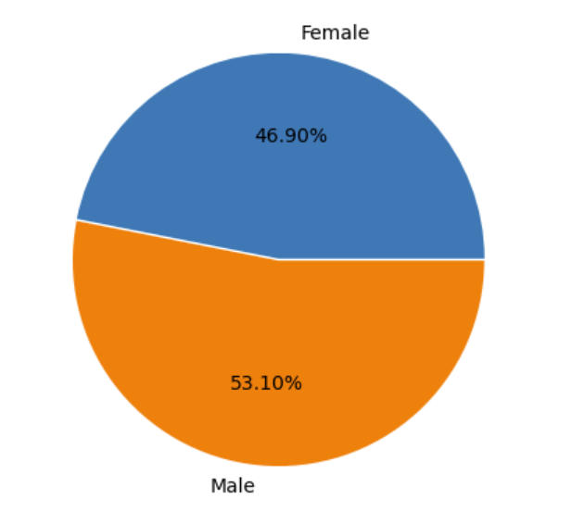
Participants Count According to Sex
Total Participant count is 4827.
Male count is more than female count.

Slide 6
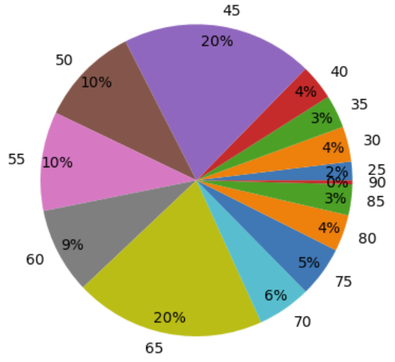
Participants Count According to Age
The age groups range from 25 to 90, with increments of 5 years.
The highest count is observed in the age group of 45, with 958 individuals.
The age groups of 50, 55, and 65 also have significant counts with 500, 496, and 954 individuals, respectively.
The data shows a gradual decrease in counts as age increases beyond 65.

Slide 7
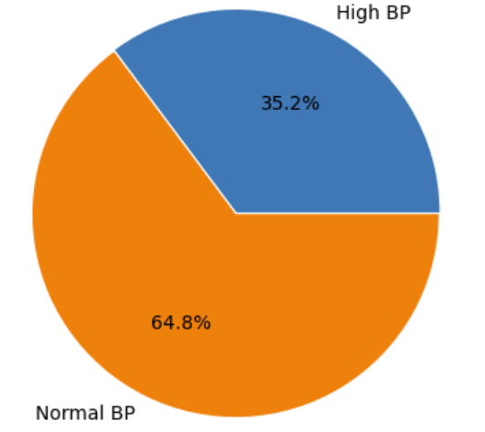
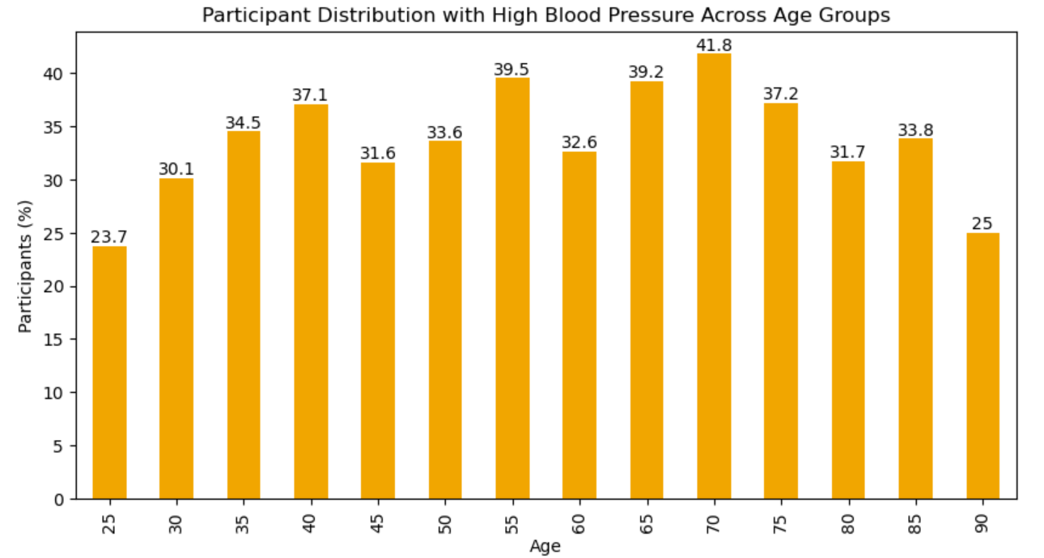
Participants with Blood Pressure Issues
Out of the total participants, 35.2% are categorized as having High BP.
This indicates a significant portion of the population under study is affected by high blood pressure.
As we move to higher age groups, the count of individuals with high BP generally increases, indicating a potential correlation between age and the prevalence of high blood pressure.

Slide 8
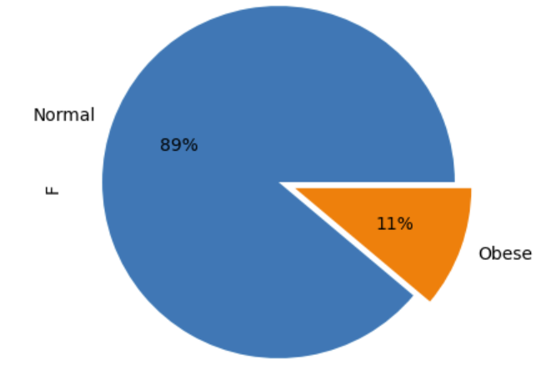
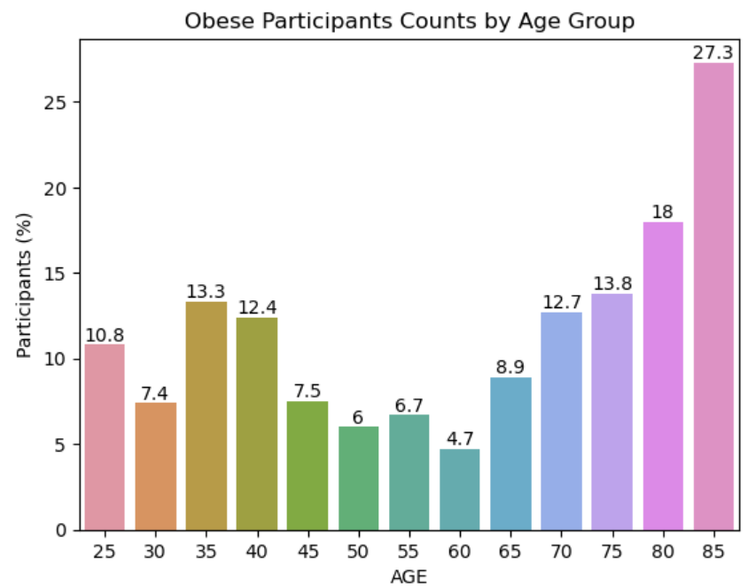
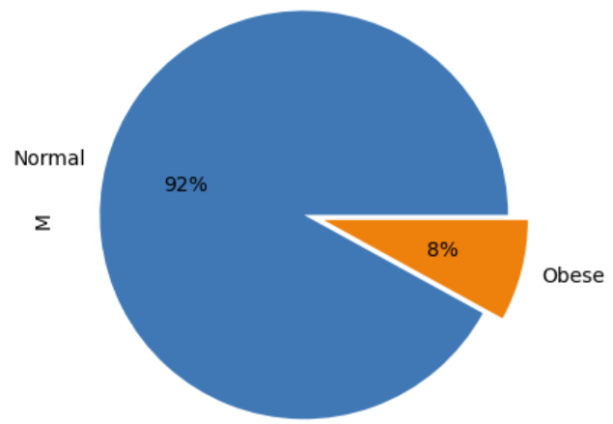
Obesity Based on BMI and W/H Ratio
While the overall obesity rate is relatively low, there is a significant gender disparity, with a higher prevalence of obesity among females compared to males.
As the age groups progress, there is a slight decrease in the percentage of non-obese individuals and a corresponding increase in the percentage of obese individuals.

Slide 9
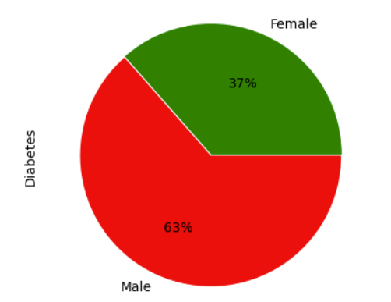
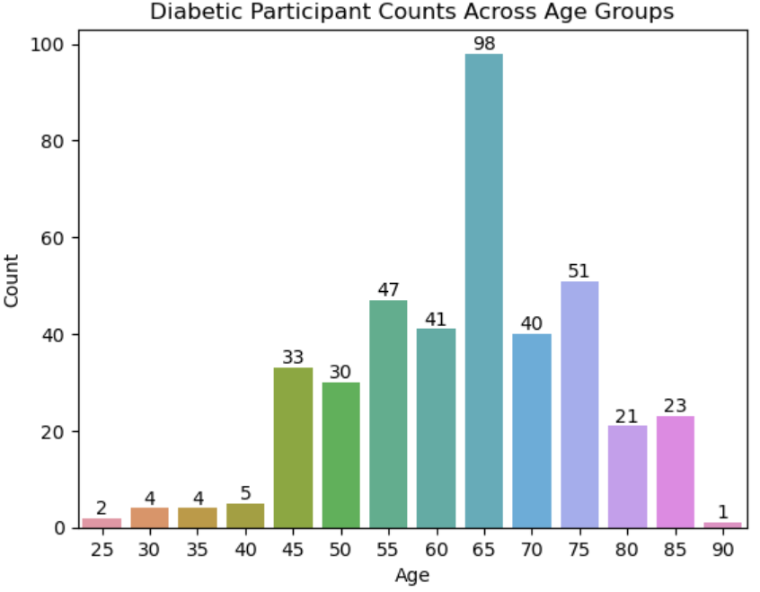
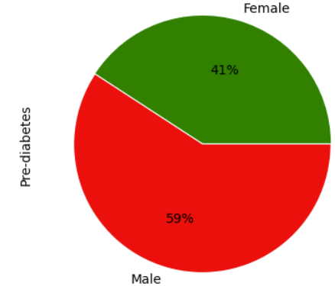
Diabetes Prevalence Among Participants
The prevalence of diabetes appears to be higher among males compared to females, with a notable difference in the percentages.
The count of individuals with diabetes gradually increases from the younger age groups to the older age groups.
Pre-diabetes shows a similar trend, with higher counts observed in the older age groups.

Slide 10
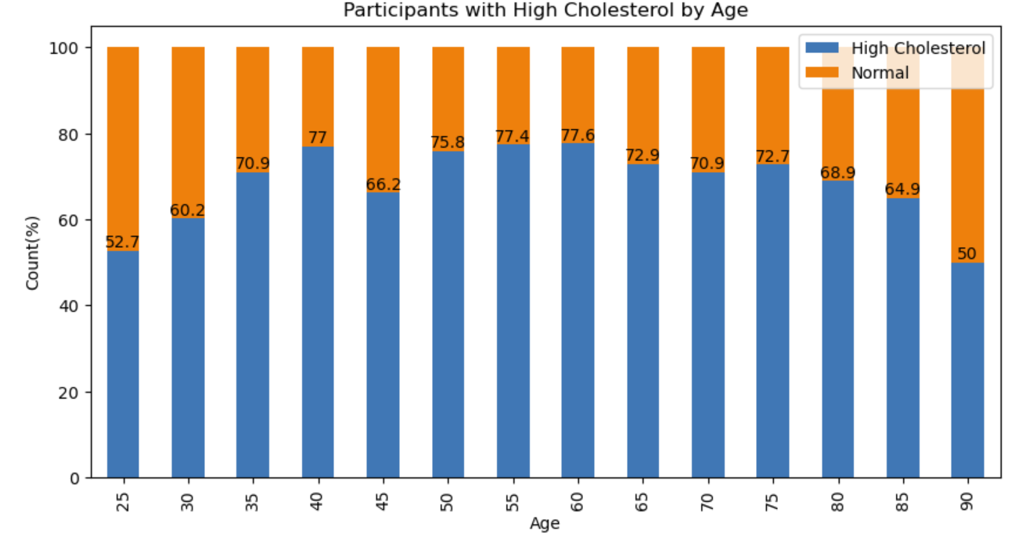
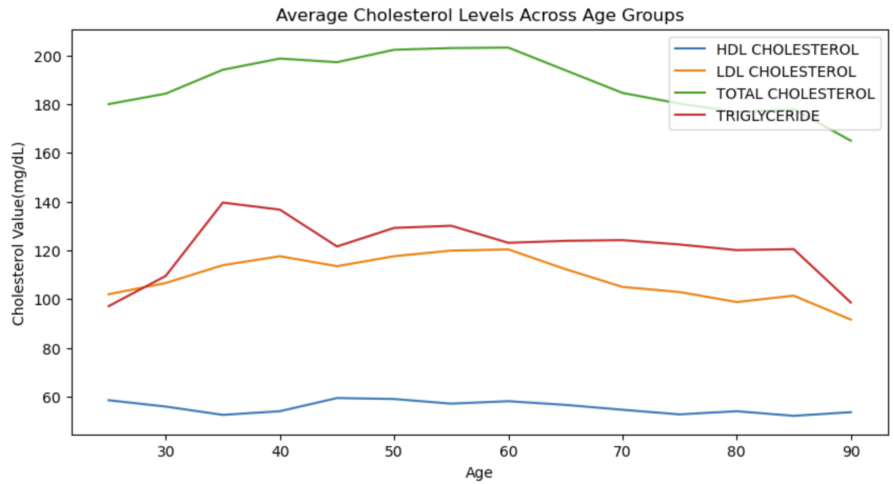
Cholesterol Levels in Participants
As age increases, the prevalence of high cholesterol tends to rise, indicating a potential age-related risk factor.
The highest percentage of high cholesterol is observed in the age group of 40, where 77% of individuals have high cholesterol, and only 23% have normal cholesterol levels.
The trends observed in the line chart indicate age-related variations in cholesterol levels, with LDL and total cholesterol generally increasing and HDL cholesterol showing a decreasing trend.

